Slide 1

MITRE ENGAGE
EMPOWERING CYBERSECURITY THROUGH ADVESARY ENGAGEMENT
MONTHLY REPORT
- SANDHYA

Slide 2

INDEX
INTERNSHIP GOAL
INTERACTION WITH MY PROFESSOR AND TEAM-MATES
3. WEEK-1&2 REPORT
4. WEEK-3 REPORT
5. WEEK-4 REPORT

Slide 3
INTERNSHIP GOALS
1) To read the MITRE Engage documents; each one of us needs to select one of the goals (Expose, Affect, and Elicit) to study deeper and define each action under these goals in detail.
2) Propose possible actions to be implemented in SSH honeypot and AD honeypot. There are about 10 to 20 actions listed under each goal. Try to propose corresponding actions for these two honeypots.
3) Real implementation: Each of us need to implement at least four actions according to your design in (2) in the real honeypots.

Slide 4
INTERNSHIP REPORT PLAN
Month 1: Orientation and Goal Selection
Month 2: Proposal and Planning
Month 3: Implementation and Documentation

Slide 5
INTERNSHIP REPORT PLAN
Week 1 & 2: Introduction to MITRE
Week 3: Goal Selection and Comprehensive Understanding
Week 4: Real-World Applications in MITRE Engage Goal

Slide 6


INTERACTION WITH OUR PROFESSOR AND TEAM-MATES
Getting along with our professor and team-mates was great as they were friendly and most welcoming.
Working with our Prof. Ren-Hung Hwang has been an inspiring journey filled with valuable mentorship and guidance.
Collaborating with such amazing teammates has been a truly positive and enriching experience.

Slide 7


FOOD IN TAINAN
We were delighted to have lunch on our DAY-1 with our professor and teammates.
We went to Guiren district in Tainan, and had various delightful meals.

Slide 8
WEEK – 1&2

Slide 9
WHY ENGAGE?
With traditional cyber defense, the adversary only needs to be right once …
… but with adversary engagement, the adversary only needs to be wrong once.

Slide 10




TRADITIONAL APPROACH
ADVERSARY ENGAGEMENT
Secure perimeter
Vulnerable interior
IP and data are legitimate, so stealing this data is a win for the adversary
Secure perimeter
Secure interior
Not all IP and data are legitimate — stealing this data does not guarantee a win for the adversary

Slide 11
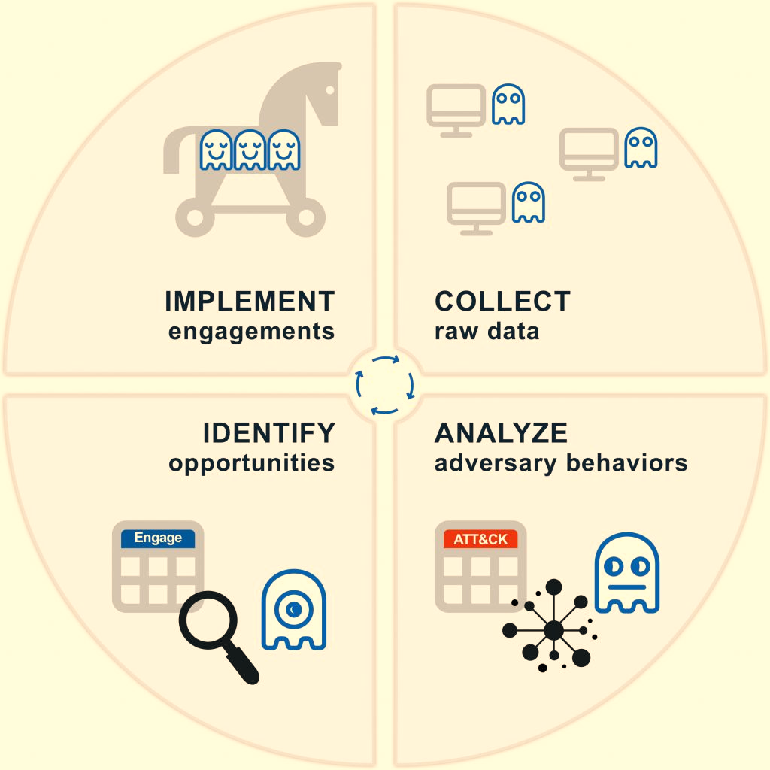
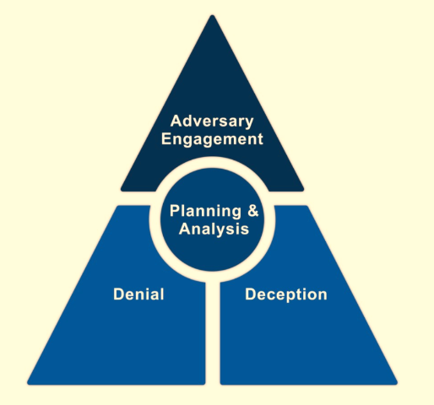
MITRE ENGAGE CYCLE
MITRE ENGAGE is a framework for planning and discussing adversary engagement operations that empowers you to engage your adversaries and achieve your cybersecurity goals.
MITRE has mainly these frameworks:
1.ATT&CK® (Adversarial Tactics, Techniques, and
Common Knowledge) Framework
2. CAR (Cyber Analytics Repository) Knowledge Base
3. ENGAGE
4. D3FEND (Detection, Denial ,and Disruption Framework Empowering Network Defense)
5. AEP (ATT&CK Emulation Plans)

Slide 12





MITRE ATT&CK is available for 3 main domains which are Enterprise, Mobile, and ICS:
1. MITRE ATT&CK For Enterprise is focused on Windows, MacOS, and the Linux.
2. MITRE ATT&CK For Mobile is focused on Android and IOS.
3. MITRE ATT&CK For ICS is focused on ICS networks.

Slide 13
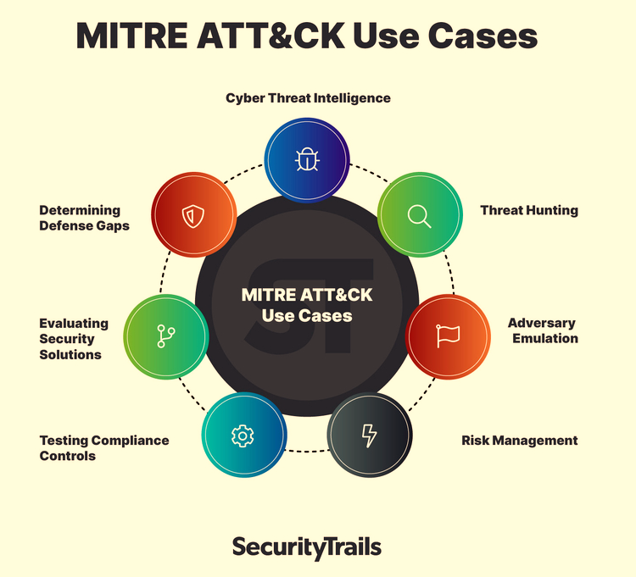
How organizations can use MITRE ATT&CK:
Throughout organizations in both the private and public sectors, the everyday activities of various teams benefit from applying ATT&CK's taxonomy. Red teams, blue teams, security operations center (SOC) analysts, threat hunters, incident responders and many other security professionals rely on the MITRE ATT&CK framework.
The MITRE ATT&CK framework shines brightest when organizations apply it to these use cases.

Slide 14
WEEK - 3

Slide 15
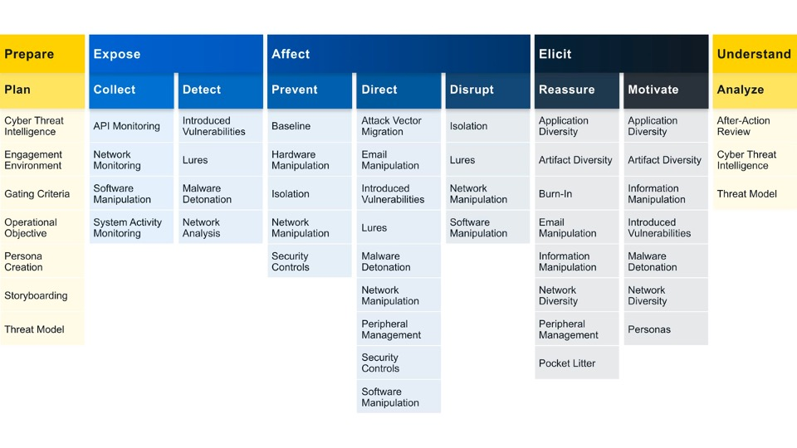
ENGAGE GOAL : EXPOSE
We can Expose adversaries on the network by using deceptive activities to provide high fidelity alerts when adversaries are active in the engagement environment.
Engage Approaches: Helps us to identify what actions we would like to take against our adversary and helps us to drive progress towards that impact.
The two engagement approaches under expose includes: COLLECT AND DETECT
COLLECT: Gather adversary tools, observe tactics, and collect other raw intelligence about the adversary’s activity.
DETECT: Establish or maintain awareness regarding adversary activity. Detection activities focus on the defender’s ability to monitor adversary activity throughout an environment, often by creating high-fidelity detections.

Slide 16
API MONITORING (ID: EAC0001): Monitor local APIs that might be used by adversary tools and activity.
API monitoring entails recording internal OS function usage, including arguments and outcomes. Analyzing this data offers deeper insights into adversary activity beyond standard system monitoring, enabling high-fidelity threat detection.
2. NETWORK MONITORING (ID: EAC0002): Monitor network traffic in order to detect adversary activity.
Network monitoring involves capturing network activity data, including server and firewall logs, which is sent to a centralized location for analysis. This analysis, whether automated or manual, helps defenders identify unusual traffic patterns and activities that may indicate adversary presence. It's crucial for situational awareness and requires careful pre-operational planning to ensure all critical network traffic is collected, aiding in detecting unexpected outbound traffic and known adversary C2 protocols.
3. SOFTWARE MANIPULATION (ID: EAC0014): Make changes to a system’s software properties and functions to achieve a desired effect.
Software Manipulation empowers defenders to modify OS, file system, or software elements, impacting outputs and hindering functionality. For instance, defenders can alter outputs of discovery commands to obscure legitimate systems and reveal deceptive ones. They may also tweak password policy descriptions to mislead adversaries
attempting brute-force attacks. This manipulation can divert adversary resources. To reduce software effectiveness, algorithms can be weakened to expose data. In extreme cases, software failures may be induced to thwart data deletion or artifact hiding. Such changes can treat adversary and user actions differently, allowing legitimate access while restricting adversaries.
4. SYSTEM ACTIVITY MONITORING (ID: EAC0003) : Collect system activity logs that can reveal adversary activity.
System log capture reveals logins, user actions, and events, providing defenders with valuable insights into adversary behavior and tools. These logs can be centrally collected for in-depth analysis, but careful planning is essential to determine what to collect without overwhelming with excess data. Understanding adversary tactics guides log selection. System activity monitoring is crucial for situational awareness and operational safety, requiring thoughtful pre-operational environment setup.

Slide 17
INTRODUCED VULNERABILITIES (ID: EAC0023): Intentionally introduce vulnerabilities into the environment for the adversary to exploit. Deliberately introducing vulnerabilities allows defenders to influence adversary actions, motivating them to target specific resources or reveal preferences and capabilities. The objectives behind introducing vulnerabilities depend on operational goals, guiding the defender's strategy and decisions.
LURES (ID: EAC0005): Deceptive systems and artifacts intended to serve as decoys, breadcrumbs, or bait to elicit a specific response from the adversary. Lures are used to provoke specific responses from adversaries, such as enabling or blocking their actions, or encouraging or discouraging particular behaviors. These baiting techniques come in various forms, such as credentials, files, system processes, and more. Regardless of the type, lures offer defenders opportunities to steer adversary actions in line with their operational objectives.
MALWARE DETONATION (ID: EAC0013) : Execute malware under controlled conditions to analyze its functionality. Malware can be safely activated in a controlled environment, but it requires clear objectives and safety protocols. The execution environment can vary from a standard malware analysis tool to a customized engagement setup. Depending on goals, this operation can yield new indicators of compromise (IOCs), reveal adversary tactics, or disrupt the adversary and their activities.
4. NETWORK ANALYSIS (ID: EAC0004) : Analyze network traffic to gain intelligence on communications between systems.
Network analysis, whether automated or manual, aims to uncover adversary activity like command and control (C2) traffic or data exfiltration. This involves capturing and examining network traffic, often requiring custom protocol decoder frameworks for complex encryption and custom protocols. Creating these decoders demands technical expertise but offers invaluable insights. For instance, decoders can decrypt network data, revealing adversary C2 or exfiltration actions, providing intelligence on communication channels, and enabling data manipulation to achieve operational goals in the future.

Slide 18
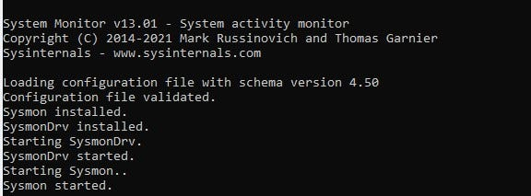
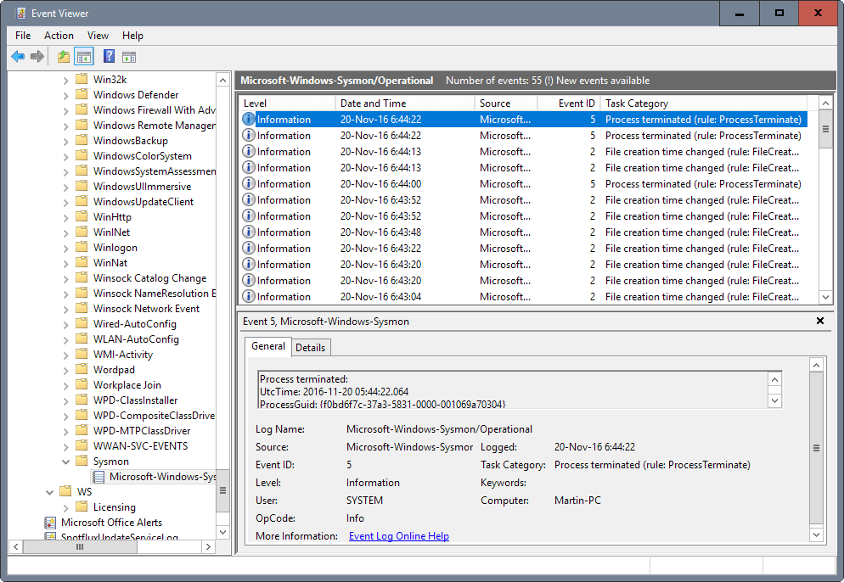
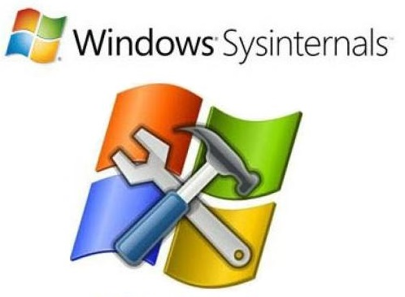
EXPLORING ADVERSARY ACTIVITY WITH SYSMON

Slide 19
What is Sysmon?
• System Monitor (Sysmon) is a Windows system service and device driver that, once installed on a system, remains resident across system reboots to monitor and log system activity to the Windows event log. It provides detailed information about process creations, network connections, changes to file creation time & a lot more.
• These log files are very important & crucial to understand issues pertaining to Windows endpoints and security.
• Installed on Windows endpoints are shows up event logs.
• Its free and gives incredible visibility into system activity on Windows endpoints.
̶ Windows XP -> System event log
̶ Vista/Windows 7 & higher - Applications and Services\logs\Microsoft\Windows\Sysmon\operational folder

Slide 20
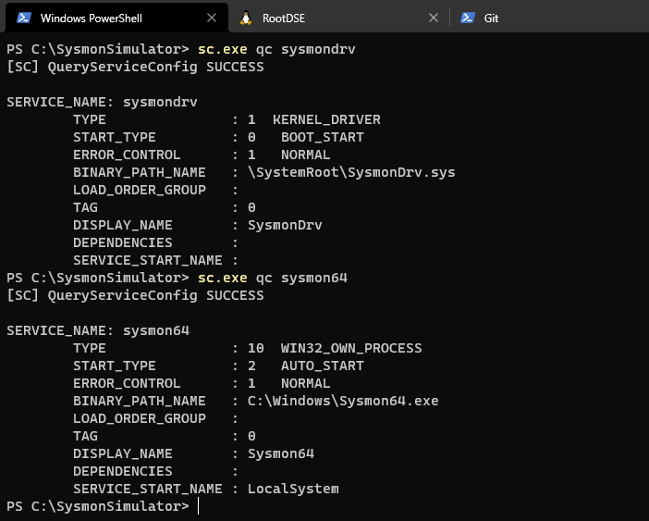
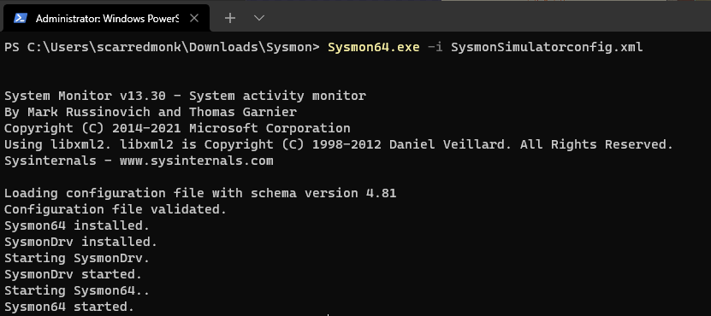
SYSMON COMMAND-LINE USAGE
Install: sysmon64 -i [<configfile>]
Update configuration: sysmon64 -c [<configfile>]
Install event manifest: sysmon64 –m
Print schema: sysmon64 –s
Uninstall: sysmon64 -u [force]
Parameter | Description
-i | Install service and driver. Optionally take a configuration file.
-c | Update configuration of an installed Sysmon driver or dump the current configuration if no other argument is provided. Optionally takes a configuration file.
-m | Install the event manifest (implicitly done on service install as well).
-s | Print configuration schema definition.
-u | Uninstall service and driver. Using -u force causes uninstall to proceed even when some components are not installed.
The installation can be verified as:

Slide 21
Sysmon Events
CATEGORY | EVENT ID
Sysmon Service Status Changed | 0
Process Creation | 1
A process changed a file creation time | 2
Network connection | 3
Sysmon service state changed | 4
Process terminated | 5
Driver loaded | 6
Image loaded | 7
CreateRemoteThread | 8
RawAccessRead | 9
ProcessAccess | 10
FileCreate | 11
RegistryEvent (Object create and delete) | 12
RegistryEvent (Value Set) | 13
RegistryEvent (Key and Value Rename) | 14
CATEGORY | EVENT ID
FileCreateStreamHash | 15
ServiceConfigurationChange | 16
PipeEvent (Pipe Created) | 17
PipeEvent (Pipe Connected) | 18
WmiEvent (WmiEventFilter activity detected) | 19
WmiEvent (WmiEventConsumer activity detected) | 20
WmiEvent (WmiEventConsumerToFilter activity detected) | 21
DNSEvent (DNS query) | 22
FileDelete (File Delete archived) | 23
Clipboard Change | 24
ProcessTampering | 25
FileDeleteDetected | 26
FileBlockExecutable | 27
FileBlockShredding | 28
FileExecutableDetected | 29
Error | 255

Slide 22
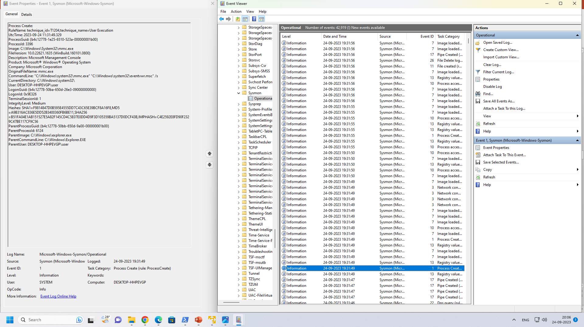
Event ID 1: Process creation:
The process creation event provides extended information about a newly created process. The full command line provides context on the process execution. The ProcessGUID field is a unique value for this process across a domain to make event correlation easier. The hash is a full hash of the file with the algorithms in the HashType field.

Slide 23
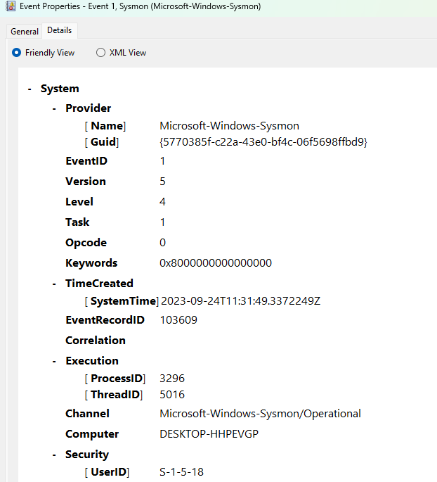
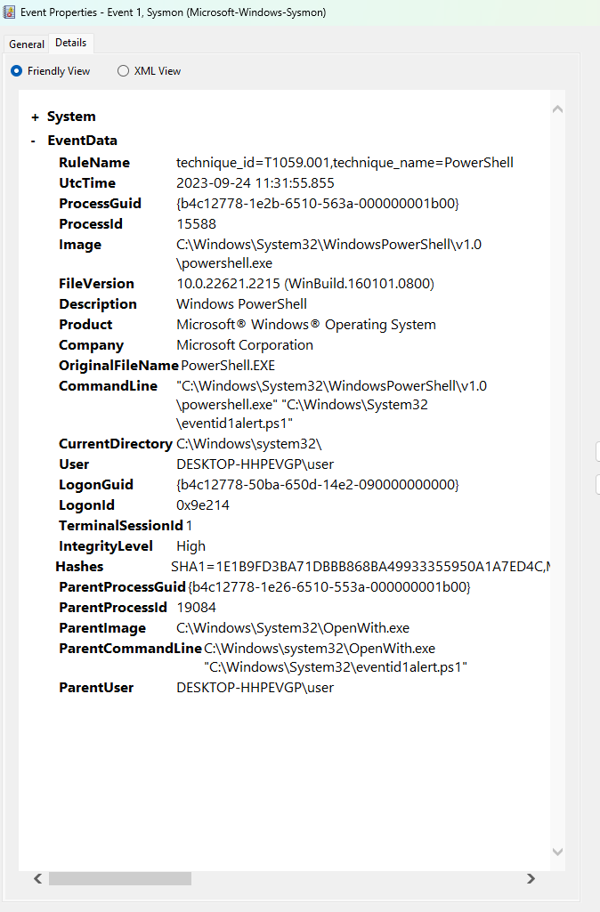

Slide 24
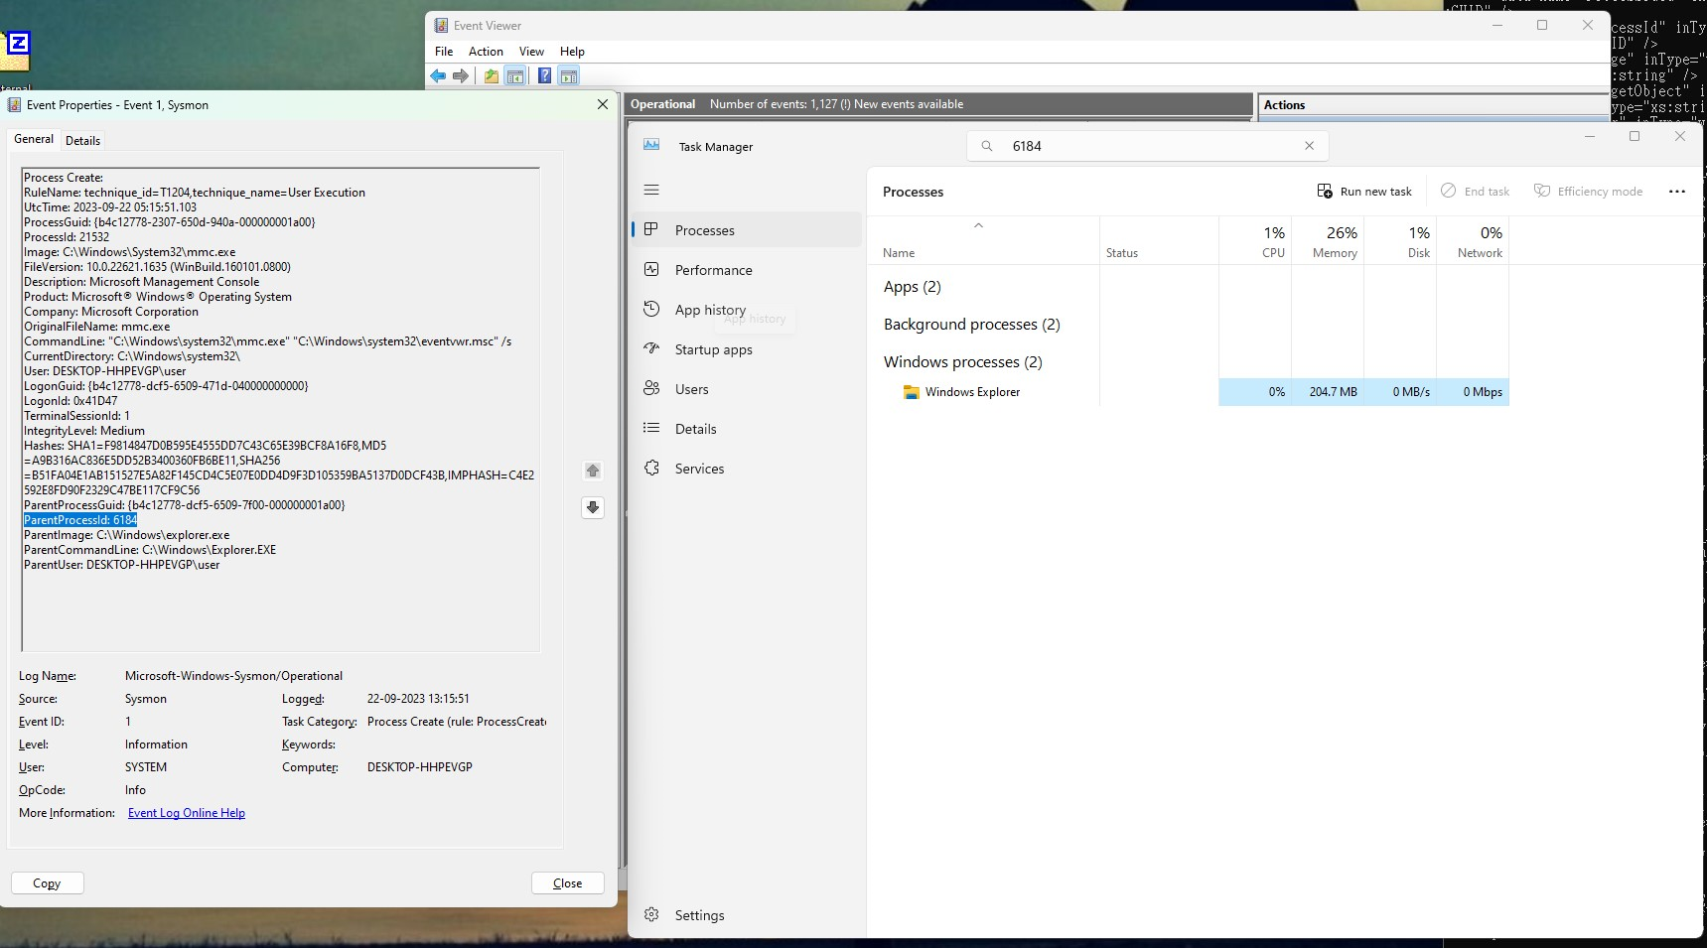
TASK MANAGER

Slide 25
THREAT HUNTING WITH SYSMON
Sysmon, a system monitoring tool that can help detect and identify suspicious behaviour.
Below we will explore how Sysmon can detect common tactics attackers use, such as Mimikatz, Pass-The-Hash, and Privilege Escalation.
Detecting Mimikatz
Mimikatz is a tool that attackers often use to extract sensitive information from a system, such as passwords and encryption keys. Sysmon can detect the use of Mimikatz on a system by monitoring certain indicators of its activity. For example, Sysmon can be configured to alert when Mimikatz attempts to inject itself into a running process (usually LSASS) or when it accesses certain sensitive data in the system’s memory.
2. Detecting Pass The Hash
Pass the hash is a technique that attackers use to authenticate to a system using the password hash of a user account rather than the actual password. Sysmon can help detect pass-the-hash attacks by monitoring for unusual network activity and using unauthorized credentials. Sysmon can be configured to alert when a network connection is made using a different user account than the one used for logging into the system. Again, what we are looking after are events regarding the LSASS process.
3. Detecting Privilege Escalation
Privilege escalation is the act of a user or program gaining access to resources or privileges that are generally unavailable. Sysmon can be used to detect privilege escalation by monitoring for changes in user privileges and the execution of programs with elevated privileges. For example, Sysmon can be alerted when a user account is added to the local administrator’s group or when a program is run with administrative rights.

Slide 26
WEEK - 4

Slide 27
NETWORK MONITORING (ID: EAC0002):
Monitor network traffic in order to detect adversary activity.
Network monitoring involves capturing network activity data, including server and firewall logs, which is sent to a centralized location for analysis. This analysis, whether automated or manual, helps defenders identify unusual traffic patterns and activities that may indicate adversary presence. It's crucial for situational awareness and requires careful pre-operational planning to ensure all critical network traffic is collected, aiding in detecting unexpected outbound traffic and known adversary C2(Command and Control) protocols.
I am going to demonstrate network monitoring tools :
NMAP(NETWORK MAPPER)
WIRESHARK

Slide 28
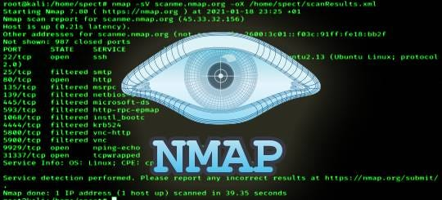
NMAP- NETWORK MAPPER
Nmap is a network scanning tool—an open-source tool that is used for mapping networks, auditing and security scanning of the networks. The reason behind its development is to quickly find large networks at a specific location. For the discovery of networks, the raw IP packets are used by Nmap.
We can use Nmap to scan IP addresses, search for security loopholes, and scan for open ports on our computer network by sending packets and analyzing the responses..
Installation process for nmap for Windows, MacBook, and Linux versions:
For Windows OS: Download and run the custom installer you get with Nmap (nmap<version>setup.exe). This will automatically configure Nmap on your Microsoft system.
For Mac OS: Run the Nmap-<version>mpkg file to start the dedicated installer (we get this with Nmap).
For Linux OS: Run the following commands after opening the terminal to install Nmap
CentOS/Fedora: sudo dnf install nmap
Ubuntu/Debian: sudo apt-get install nmap

Slide 29
Uses Of NMAP
Scan every active IP address: We can get detailed information on every IP active on our network to determine whether an IP has been compromised. Nmap will tell us whether a legitimate service or an external hacker is using the IP.
Perform entire network scanning: We can get information on our network as a whole, including a list of live hosts and open ports and the OS of every connected device. Due to this, Nmap does a great job at monitoring our ongoing system and helping perform pen-testing.
Identify server vulnerabilities: We can use the tool to scan our web server for any security gaps to protect personal and business websites. Nmap helps simulate the process a malicious agent would typically use to attack our website.
Develop visual mappings: Nmap has a graphical user interface known as Zenmap. We can use it to create visual mappings of our network to facilitate better usability and reporting.
Automate system and vulnerability scans: Nmap has an incredible feature known as “Nmap Scripting Engine” (NSE). It's a scripting engine that lets us use a predefined set of scripts and automate networking features. Alternatively, we can write our own NSE scripts using the Lua programming language to make conclusions about the target host/service.

Slide 30
NMAP Commands Cheat Sheet
1. Nmap commands for Port Selection:
Description | Commands
1. To scan a single port using Nmap: | nmap -p 8 192.168.1.1
2. To scan a range of ports using Nmap: | nmap -p 1-20 192.168.1.1
3. For scanning common ports of the network: | nmap -F 192.168.1.1
4. If you want to scan all the 65532 ports of the network, then use the corresponding command: | nmap -p- 192.168.1.1
2. Nmap Commands for Target Selection:
Description | Commands
1. To scan a single IP host: | nmap 192.168.1.1
2. For scanning the range of IPs: | nmap 192.168.1.1-15
3. If you want to scan a single host: | nmap www.<hostname>.com
4. For scanning targets from text file, you should use the corresponding Nmap command: | nmap -iL target-ip-lists.txt

Slide 31
NMAP Commands Cheat Sheet
3. Nmap commands for OS and Version Detection:
Description | Commands
1. For detection of OS and the services: | nmap -A 192.168.1.1
2. To detect aggressive services: | nmap -sV –version-intensity 4 192.168.1.1
3. For standard version detection: | nmap -sV 192.168.1.1
4. Nmap commands for different Output Formats:
Description | Commands
If you want to save default output to a file: | nmap -oN op.txt 192.168.1.1
To save the output in all formats: | nmap -oA op 192.168.1.1
To save results in XML format: | nmap -oX op.xml 192.168.1.1
To save the Nmap results in format for grep: | nmap -oG op.txt 192.168.1.1
5. Nmap command for IP address info:
To get the information of IP Address: | nmap- –script=asn-query, whois, ip-geolocation-stateloc 192.168.0.1/22

Slide 32
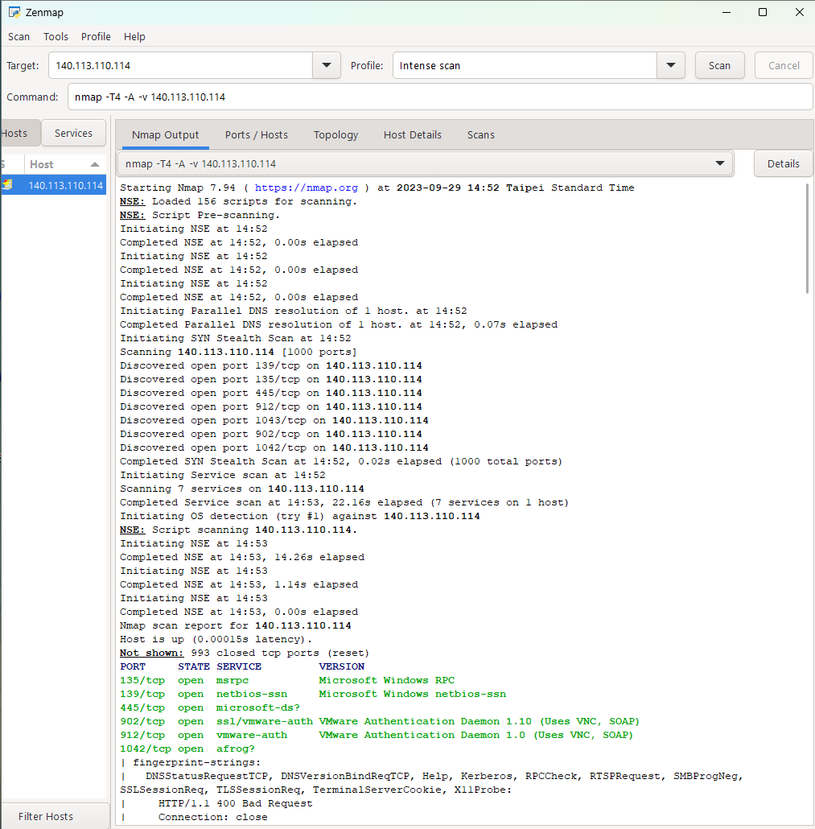
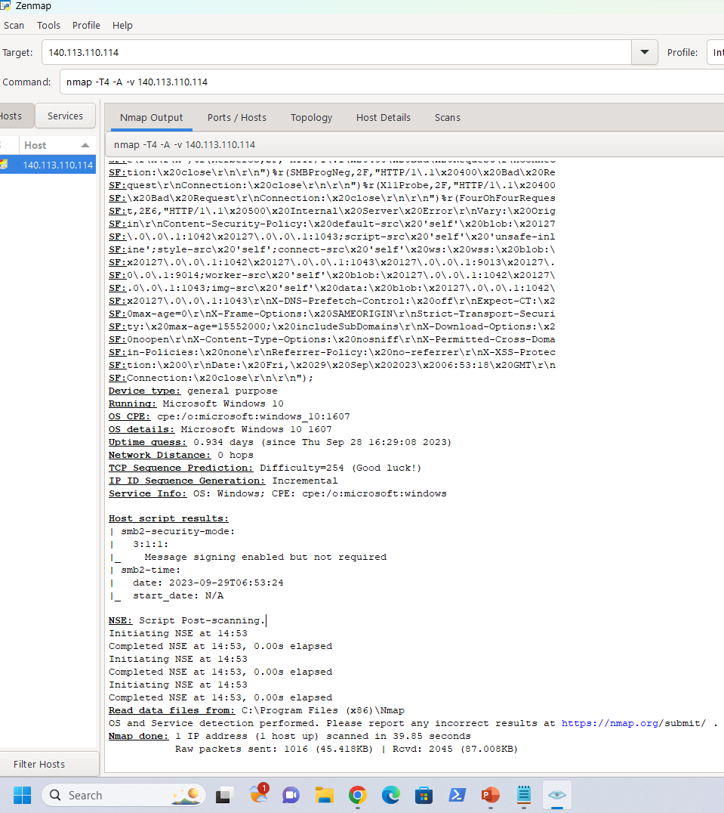

Slide 33
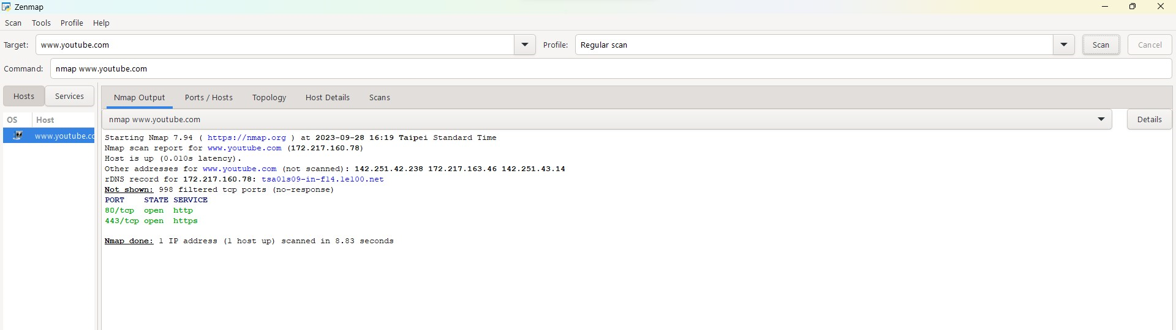
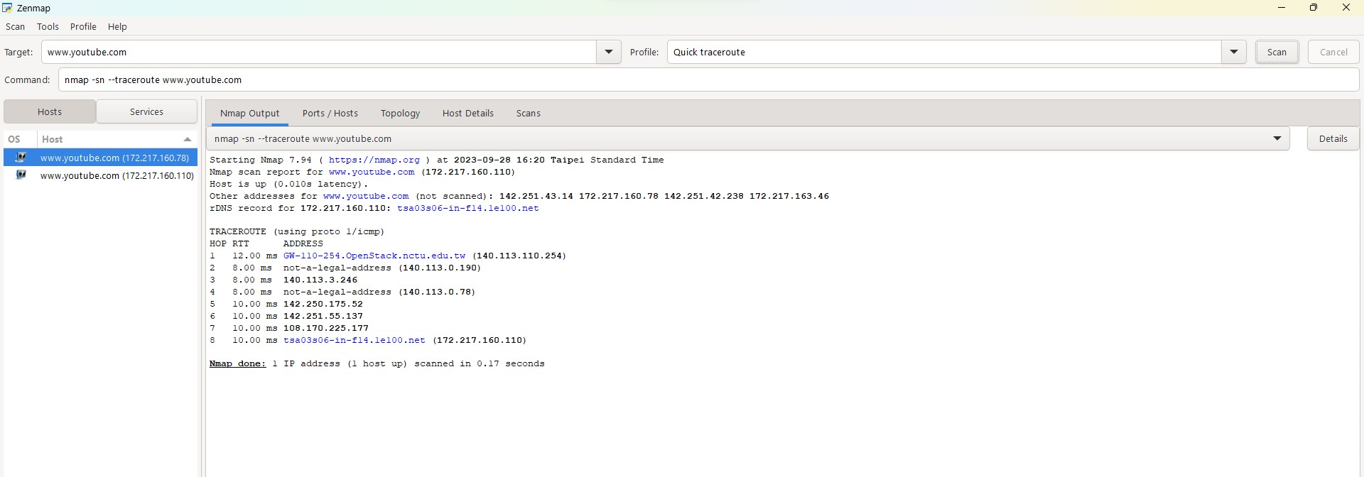

Slide 34
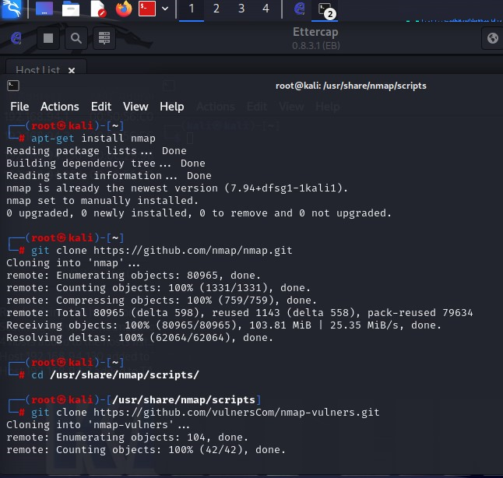
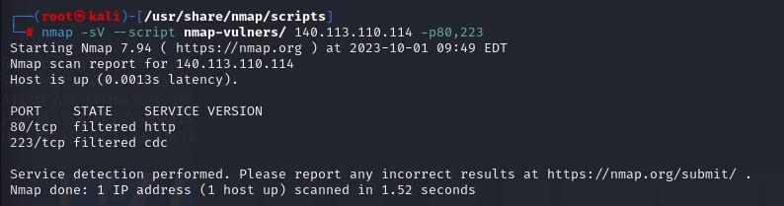
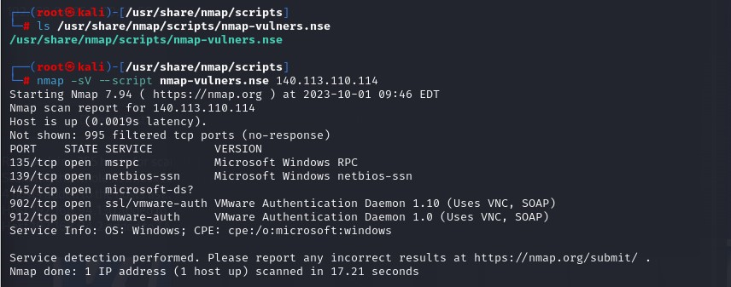
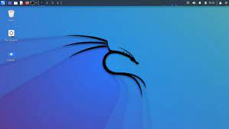
Vulnerability Scanning with Nmap using specified ports
Installation
Vulnerability Scanning with Nmap
Kali Linux

Slide 35


WIRESHARK
Wireshark is a software tool used to monitor the network traffic through a network interface. It is a network protocol analyzer, or an application that captures packets from a network connection, such as from our computer to our home office or the internet. Packet is the name given to a discrete unit of data in a typical Ethernet network.
Wireshark is the most often-used packet sniffer in the world. Like any other packet sniffer, Wireshark does three things:
Packet Capture: Wireshark listens to a network connection in real time and then grabs entire streams of traffic.
Filtering: Wireshark is capable of slicing and dicing all of this random live data using filters. By applying a filter, we can obtain just the information we need to see.
Visualization: Wireshark, like any good packet sniffer, it allows us to dive right into the very middle of a network packet. It also allows us to visualize entire conversations and network streams.
The basic features of Wireshark are:
Packet Monitor: This segment visually shows the packets flowing inside the network. There are color codes for each type of packet. The packets are shown with the following information : 1. Source address 2. Destination address 3. Packet type 4. Hex dump of the packet 5. Contents of the packet in text 6. Source port(if applicable) 7. Destination port(if applicable)

Slide 36
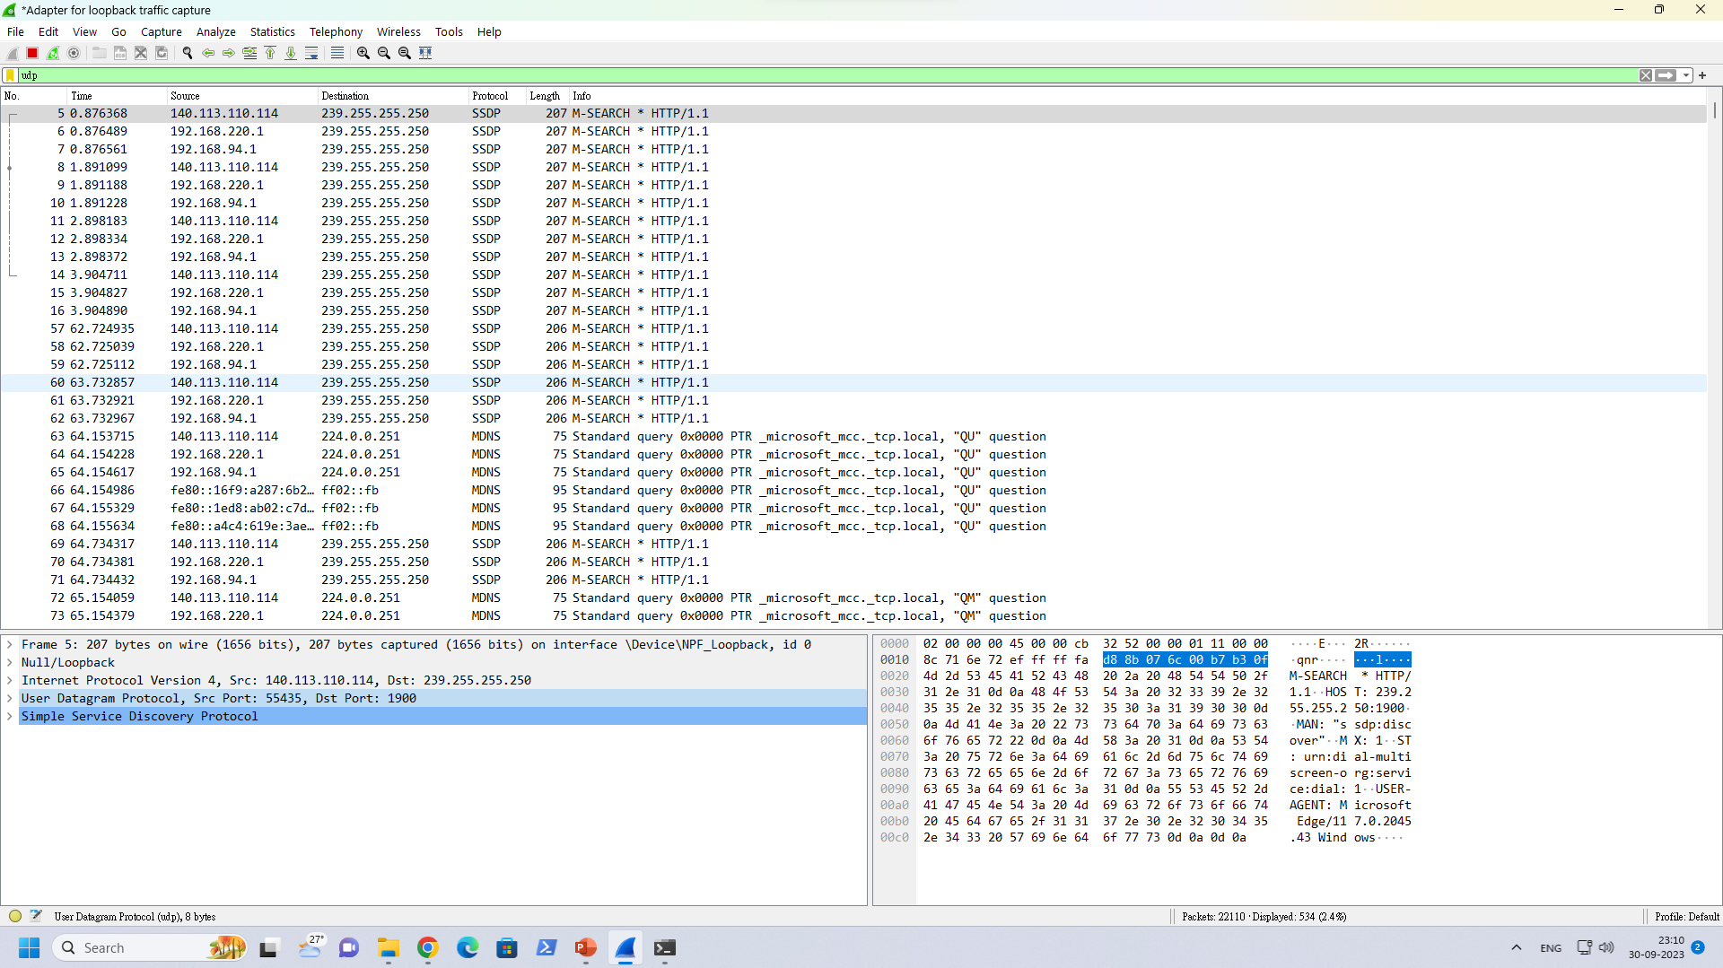
Network Traffic Trace :
A recording of the network packets both received by and transmitted from a network interface.
What is a pcap file?
pcap = Packet Capture
File format originally designed for tcpdump/libpcap
Most widely used packet capture format
Basic UI
Menu
Packet List
Packet Bytes
Packet Details
Wireshark interface

Slide 37
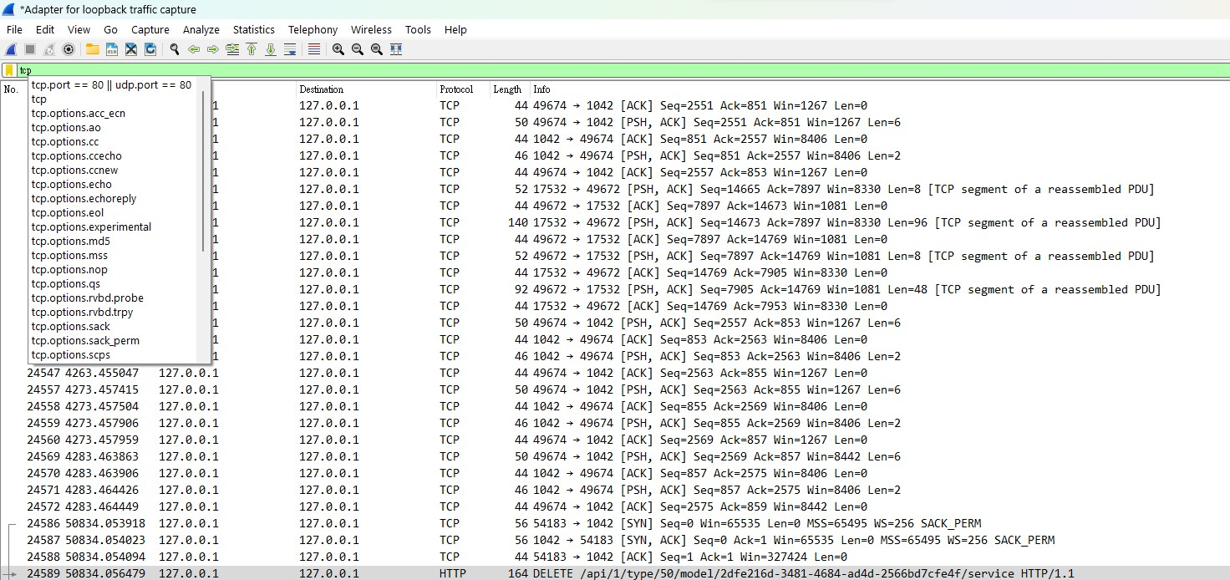
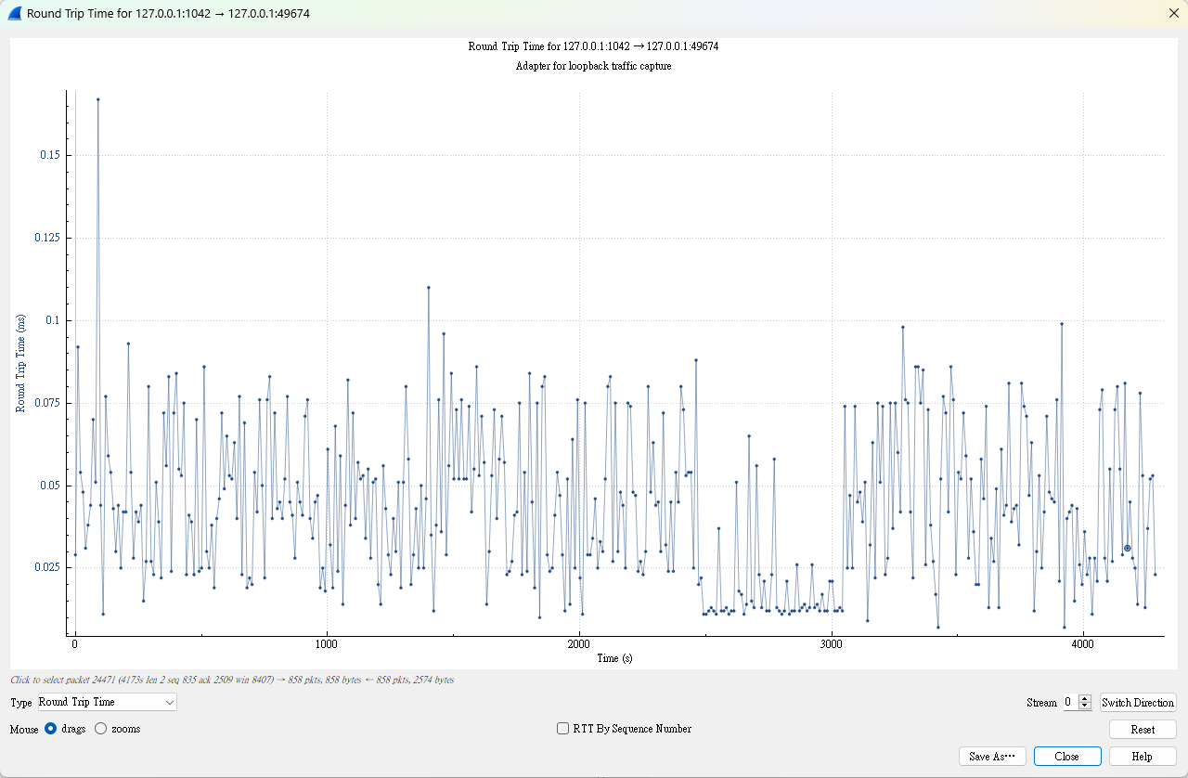
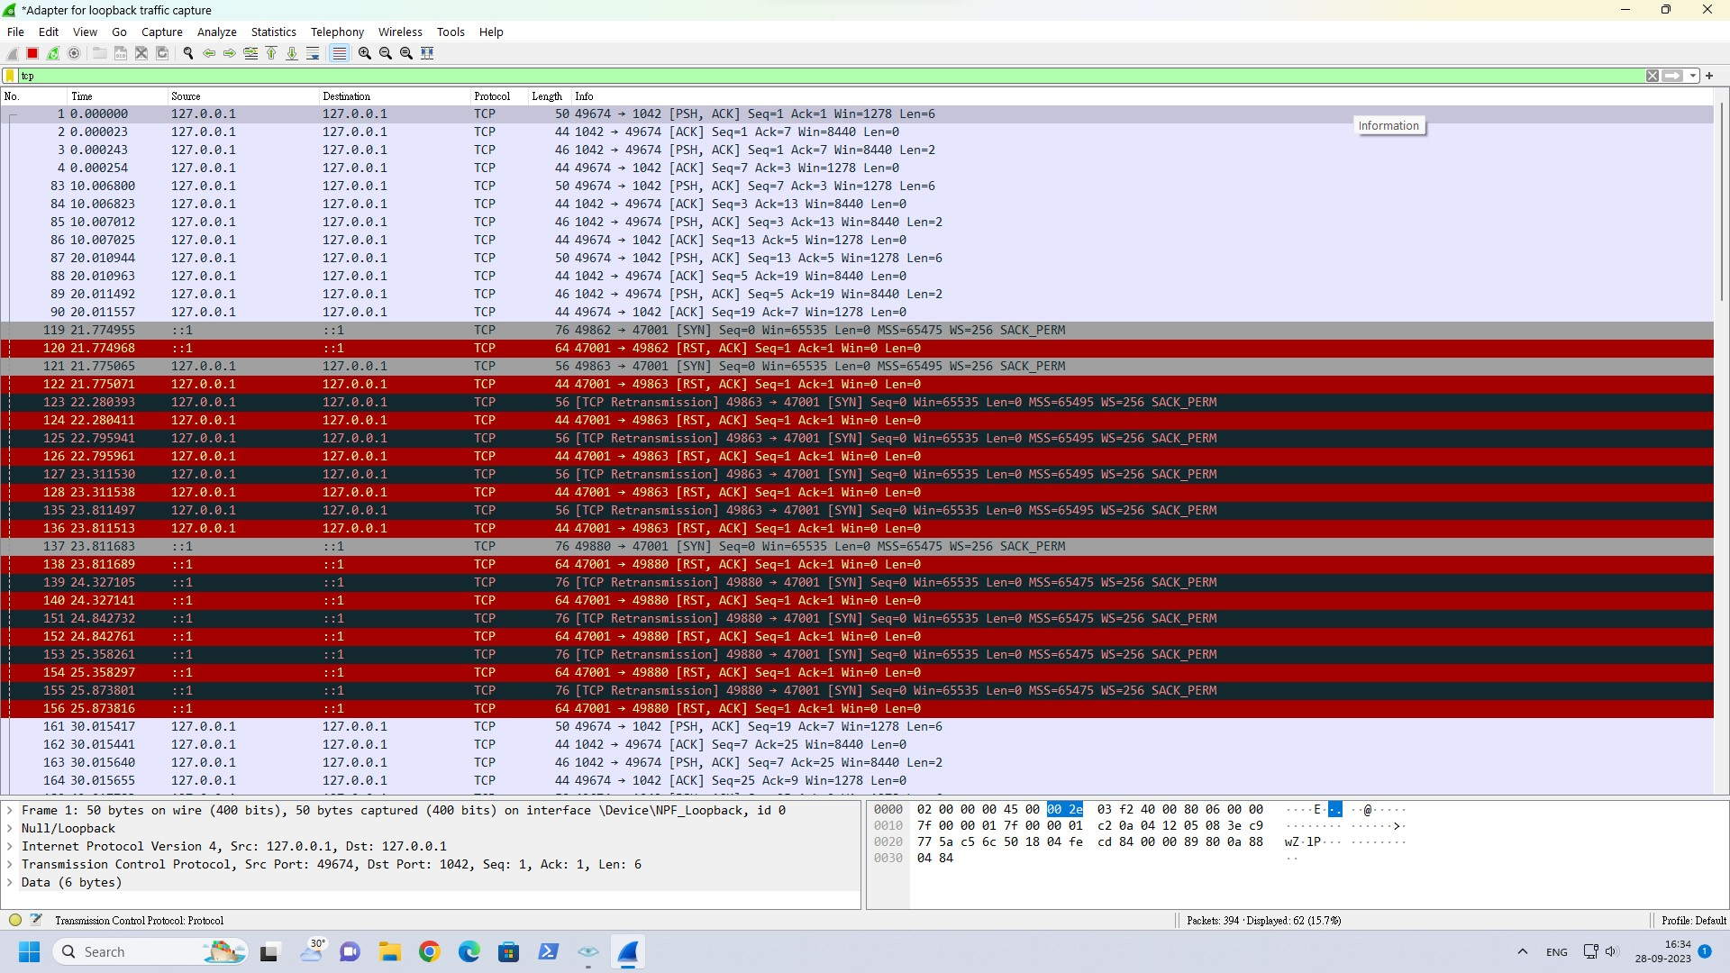

TCP Filter
Statistics-> Tcp Stream graphs -> RTT(Round Trip Time)
UDP Filter
Checksum errors and tcp reset shown in black and red colour filters

Slide 38
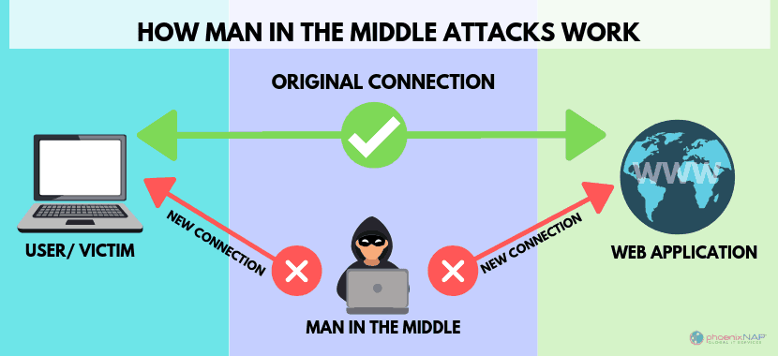


REAL IMPLEMENTATION OF WIRESHARK TO DETECT MITM ATTACK
A man in the middle (MITM) attack is a general term for when a perpetrator positions himself in a conversation between a user and an application—either to eavesdrop or to impersonate one of the parties, making it appear as if a normal exchange of information is taking place.
The goal of an attack is to steal personal information, such as login credentials, account details and credit card numbers. Targets are typically the users of financial applications, SaaS businesses, e-commerce sites and other websites where logging in is required.
Information obtained during an attack could be used for many purposes, including identity theft, unapproved fund transfers or an illicit password change.
To perform this I am going to use Kali Linux and windows operating system,
where Kali Linux machine will be the attacker machine and windows will be the
victim machine.

Slide 39
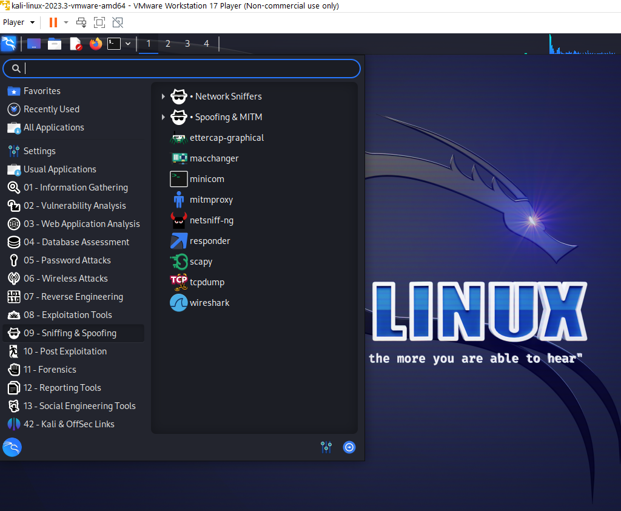
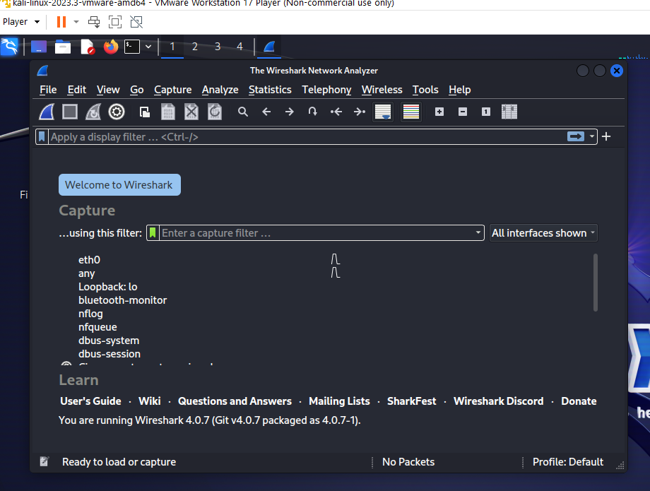

Slide 40
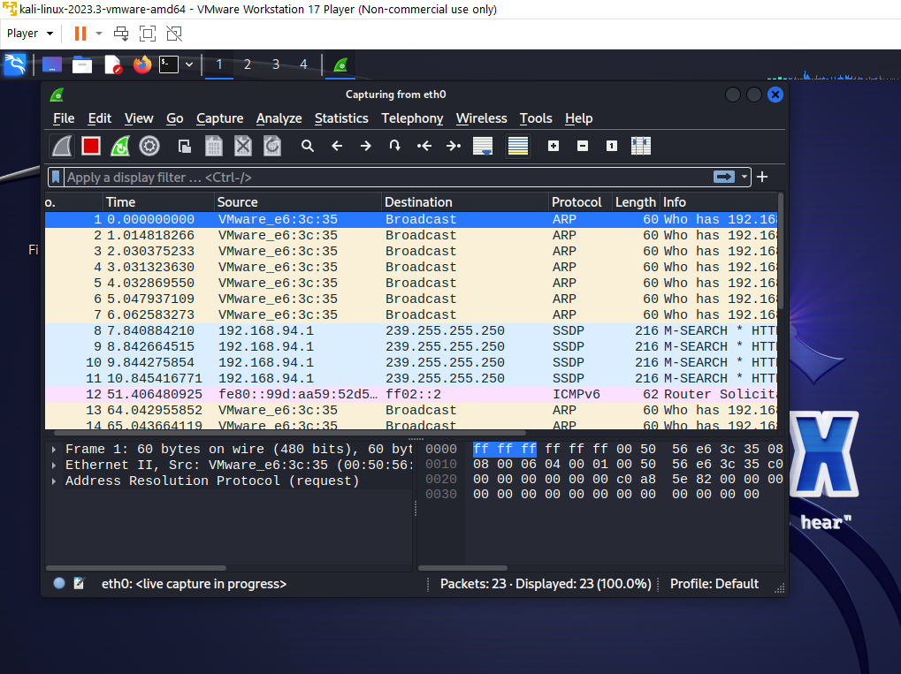

Slide 41
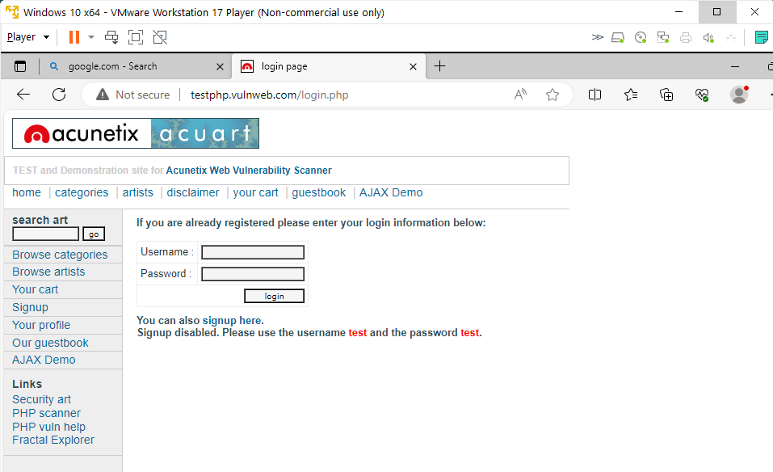
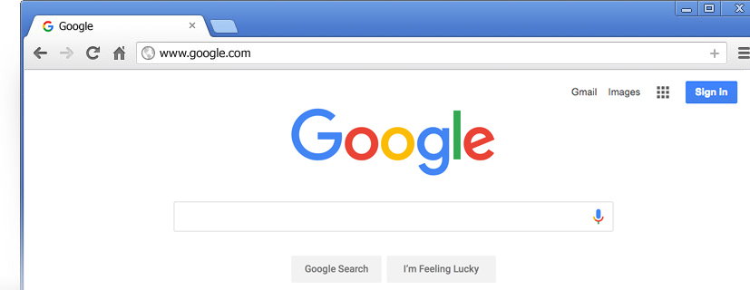
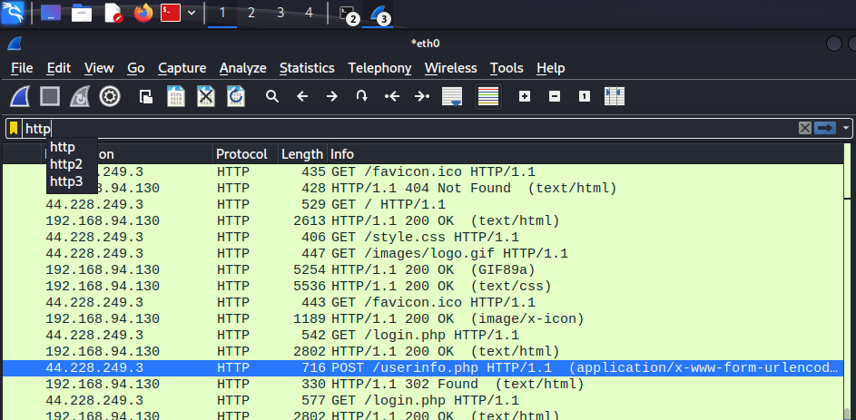
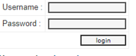
Sandhya
Sandhya1207

Slide 42
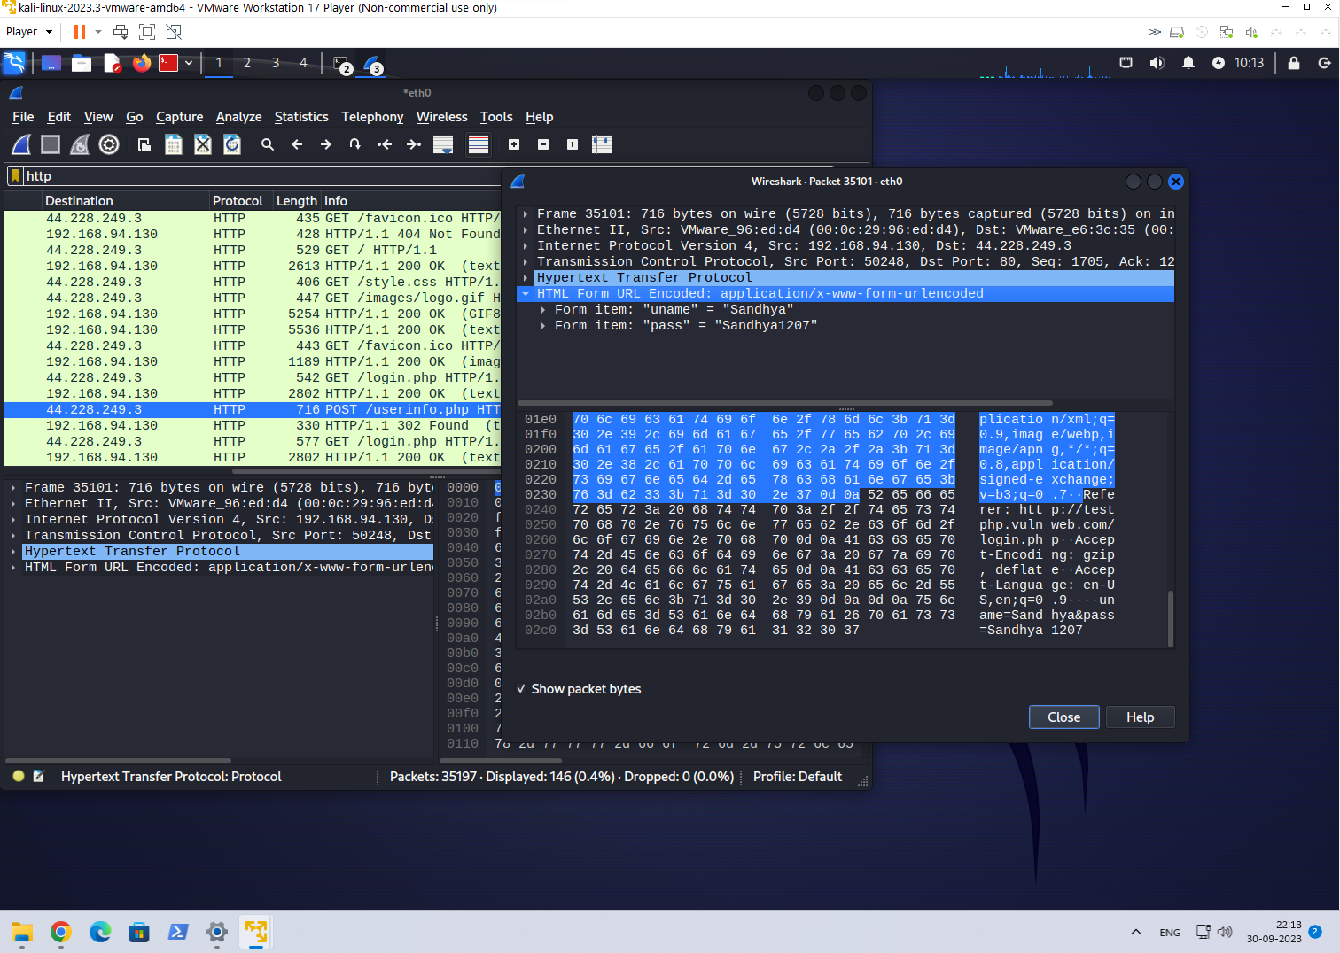

Slide 43
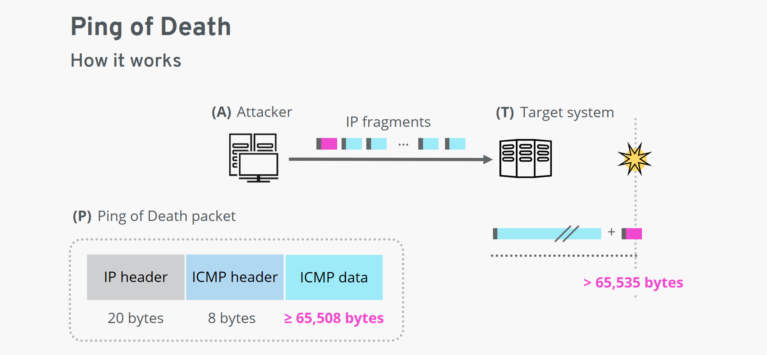
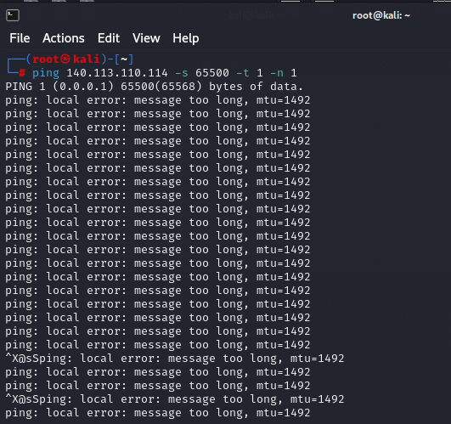
REAL IMPLEMENTATION OF WIRESHARK TO DETECT DOS ATTACK
A Denial-of-service (DoS) attack is a malicious attempt to disrupt the normal traffic of a targeted server, service or network by overwhelming the target or its surrounding infrastructure with a flood of Internet traffic.
A ping of death is a Denial of Service (DoS) attack. To start the attack, one sends a malicious data packet to the target. When the data packet is processed by the target system, the system encounters an error that causes it to crash.
The ping command, from which the attack gets its name, is usually used to test whether a network is reachable. It’s based on the Internet Control Message Protocol (ICMP), which is used to communicate status information on the Internet.
Ping of death on Windows:
ping <ip address> -l 65500 -w 1 -n 1
Ping of death on Linux/UNIX/macOS:
ping <ip address> -s 65500 -t 1 -n 1
IP Address : 140.113.110.114

Slide 44
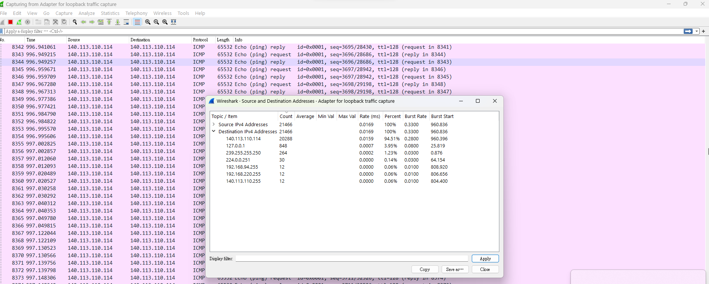
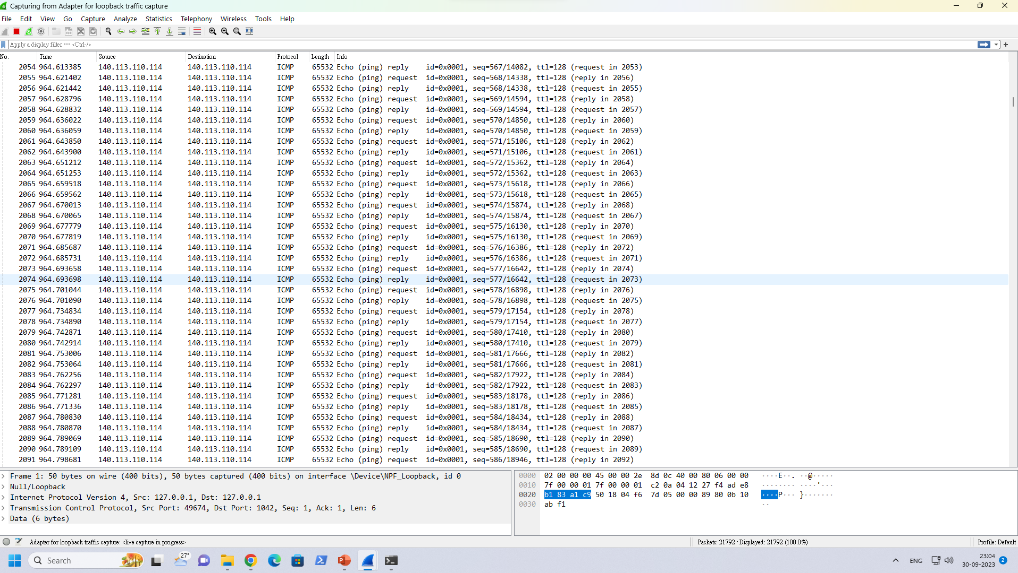
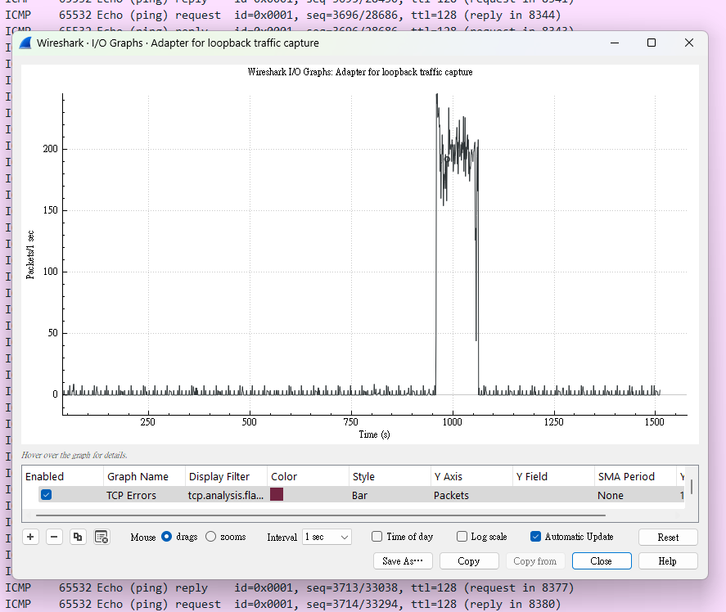
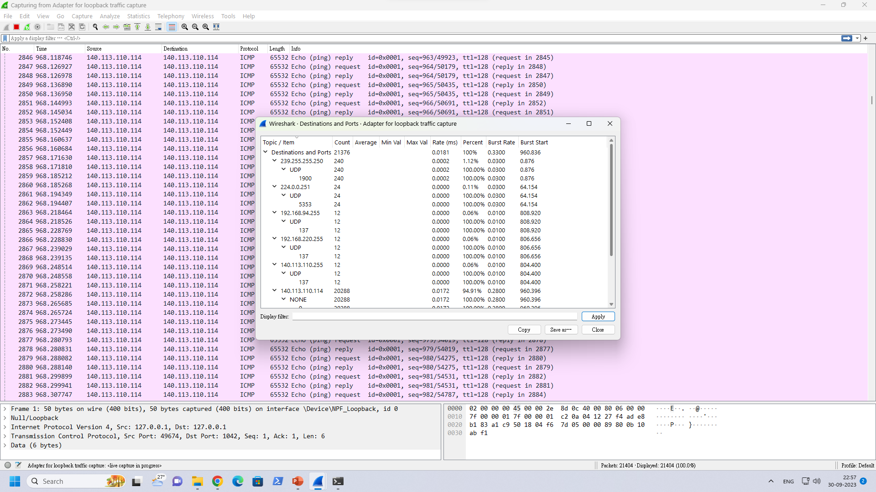
PING command packets in wireshark
Destination And Ports

Slide 45
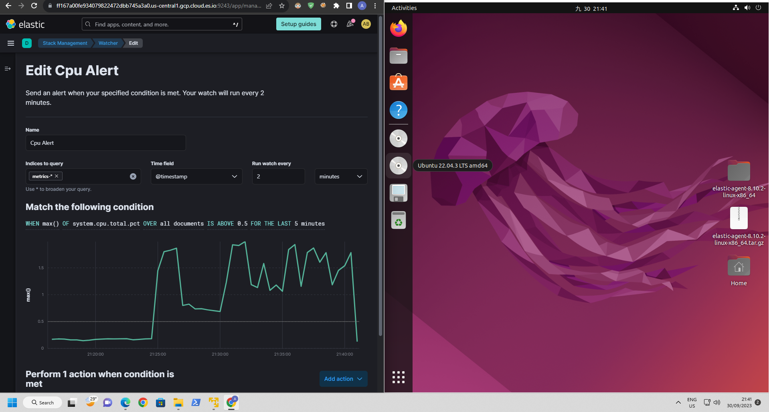

Slide 46
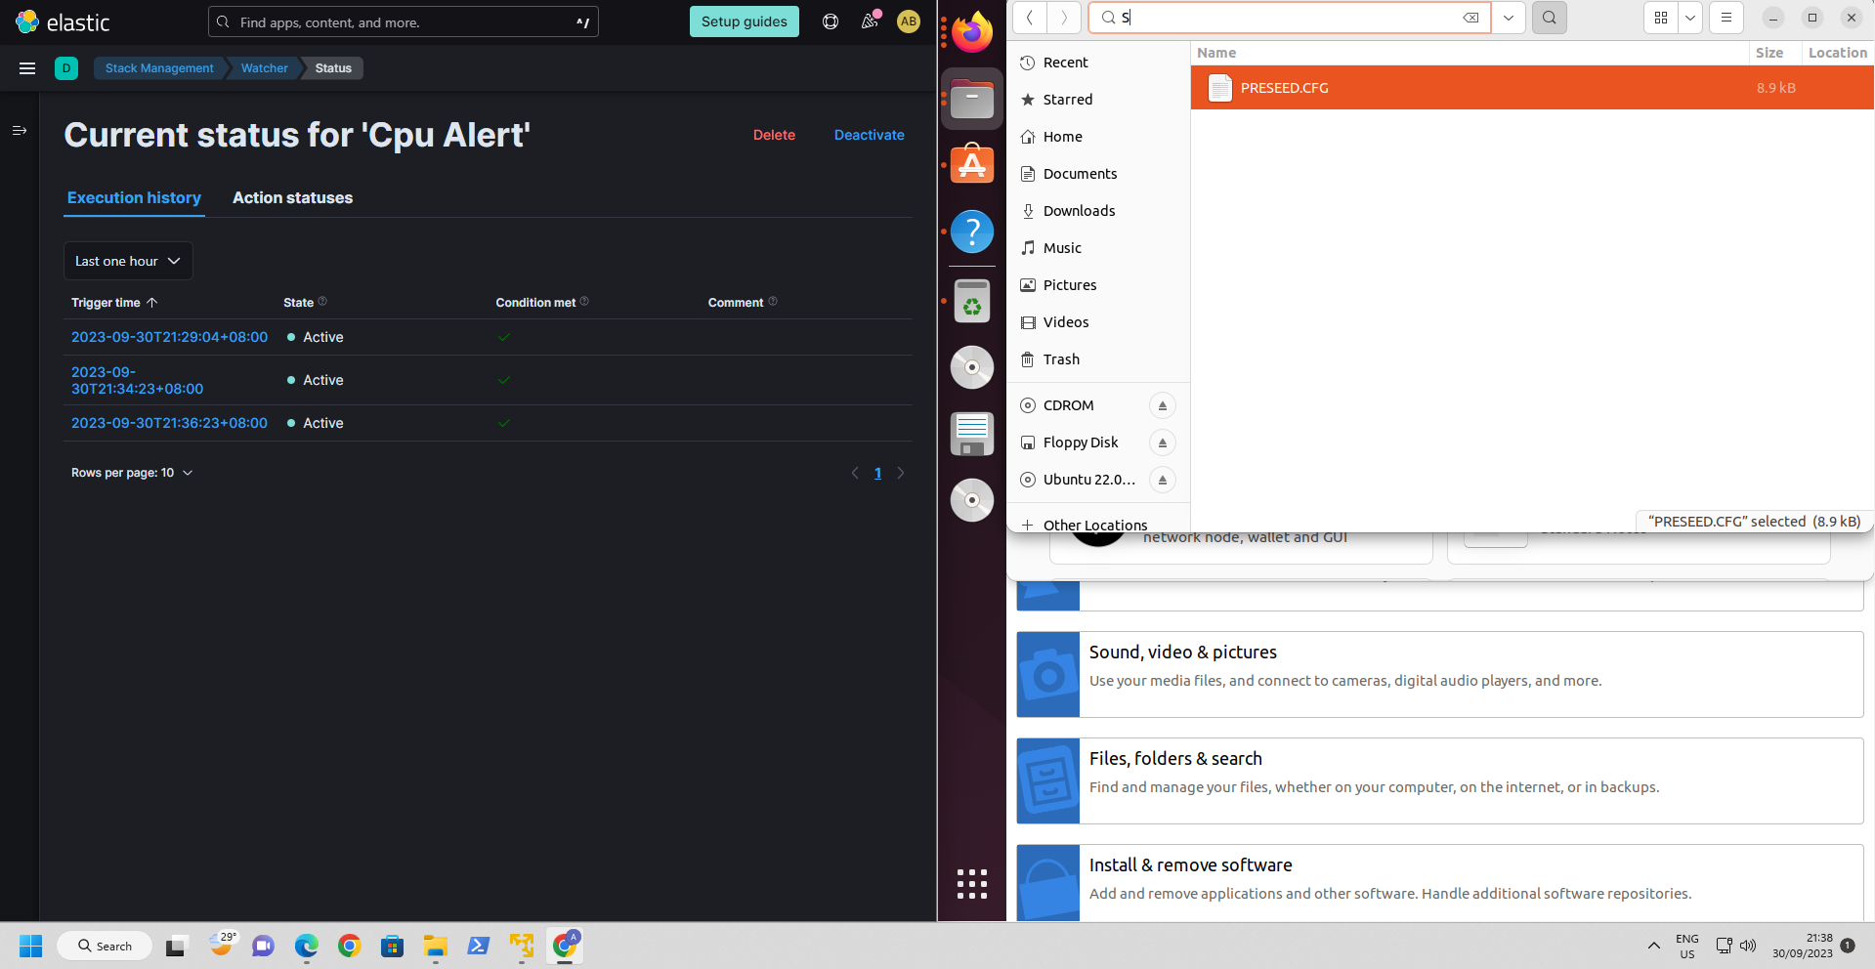

Slide 47
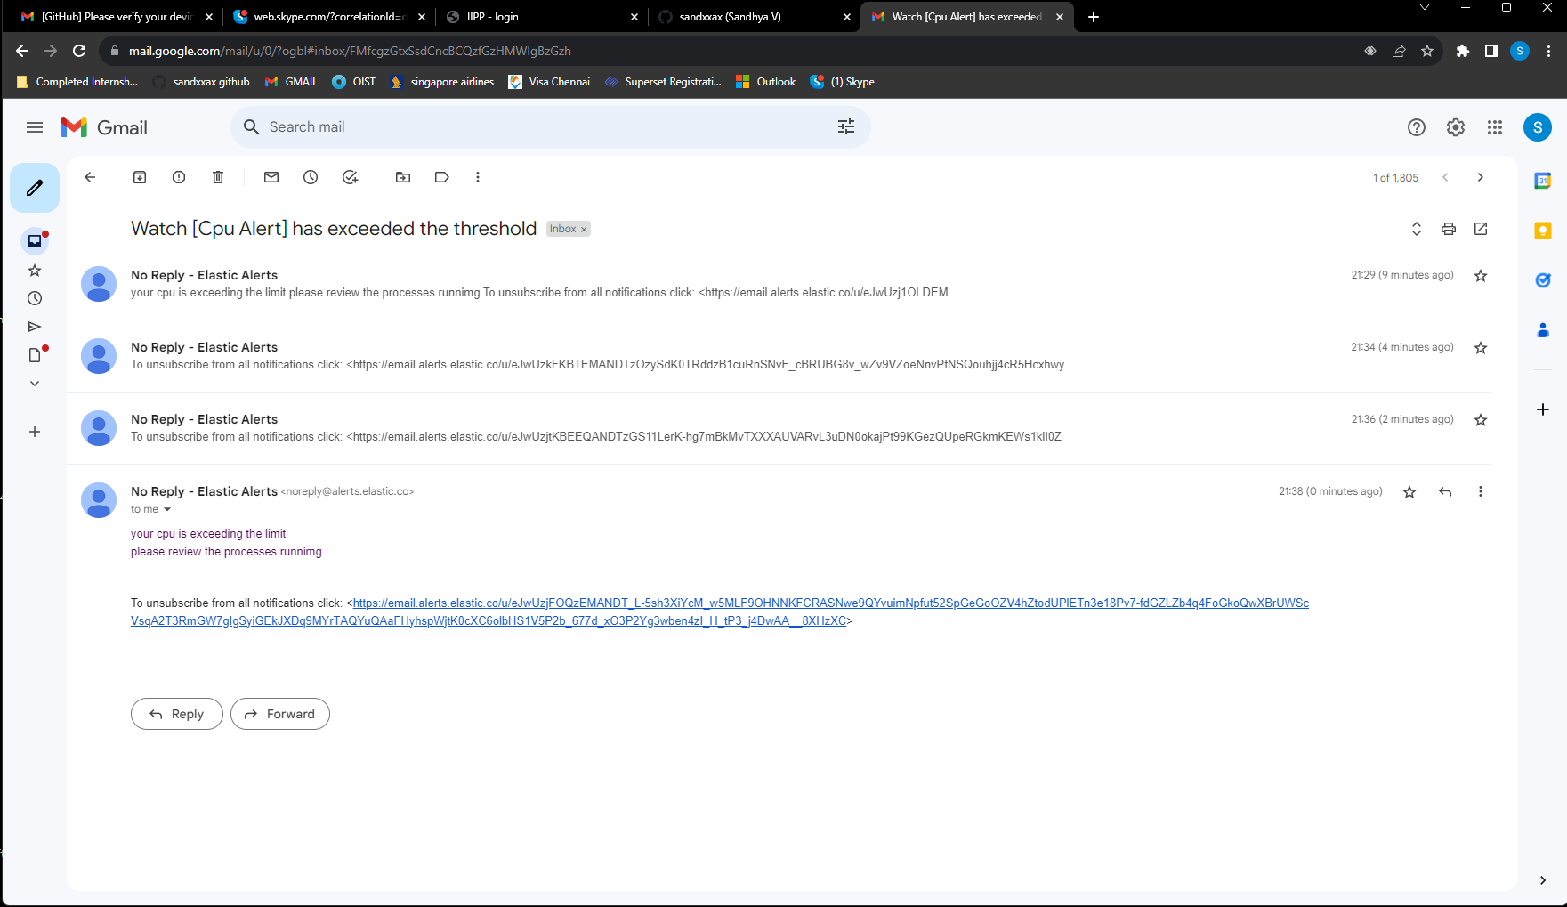

Slide 48


